Slide 1


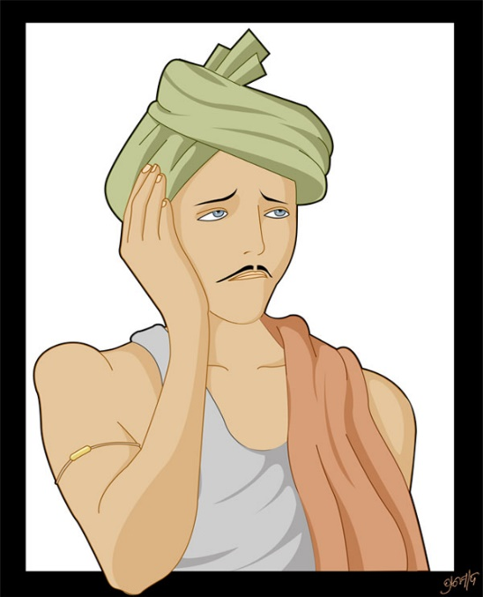

E GOVERNANCE IN YOUR SMART VILLAGE
PRESENTED BY
NAME: M N V VISWANADH
CENTER: VRSEC, VIJAYWADA
COLLEGE: VRSEC, MTECH

Slide 2
CONTENTS
VILLAGE PROBLEMS OR STATUS
AUTHORITIES INFORMATION
ADMINISTRATION SERVICES
OTHER SERVICES

Slide 3
COMPLAINT OR STATUS
FOOD & HEALTH
GOVERNMENT SCHEMES
EDUCATION
AGRICULTURE
PANCHAYAT ISSUES

Slide 4
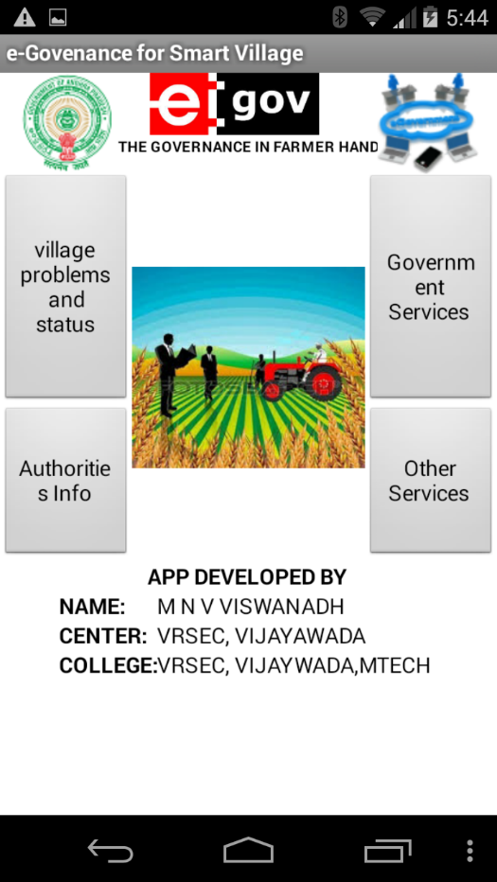
SCREEN SHOT

